Slide 1
Math Doesn’t Have to be Hard: Logic Block Architectures to Enhance Low-Precision Multiply-Accumulate on FPGAs
汇报人：潘承愿
Aug 5, 2021

Slide 2


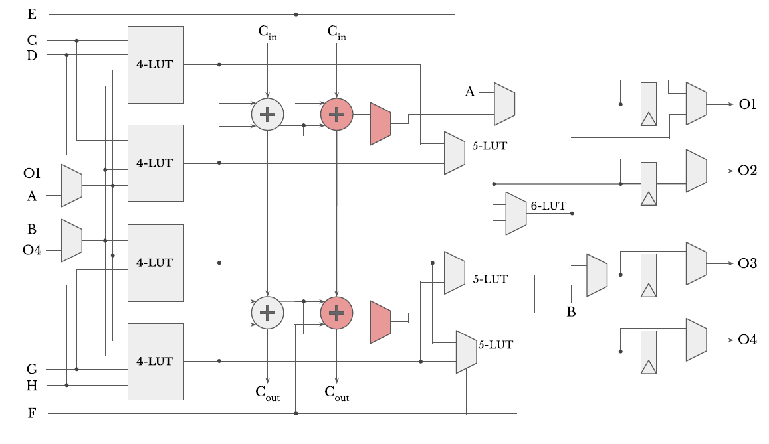
Adapative Logic Module (ALM)

Slide 3
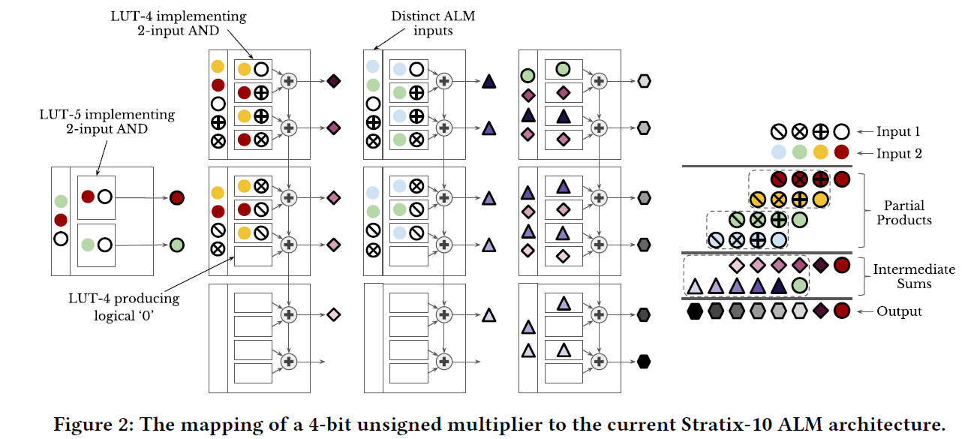
Low-Precision Multipliers

Slide 4
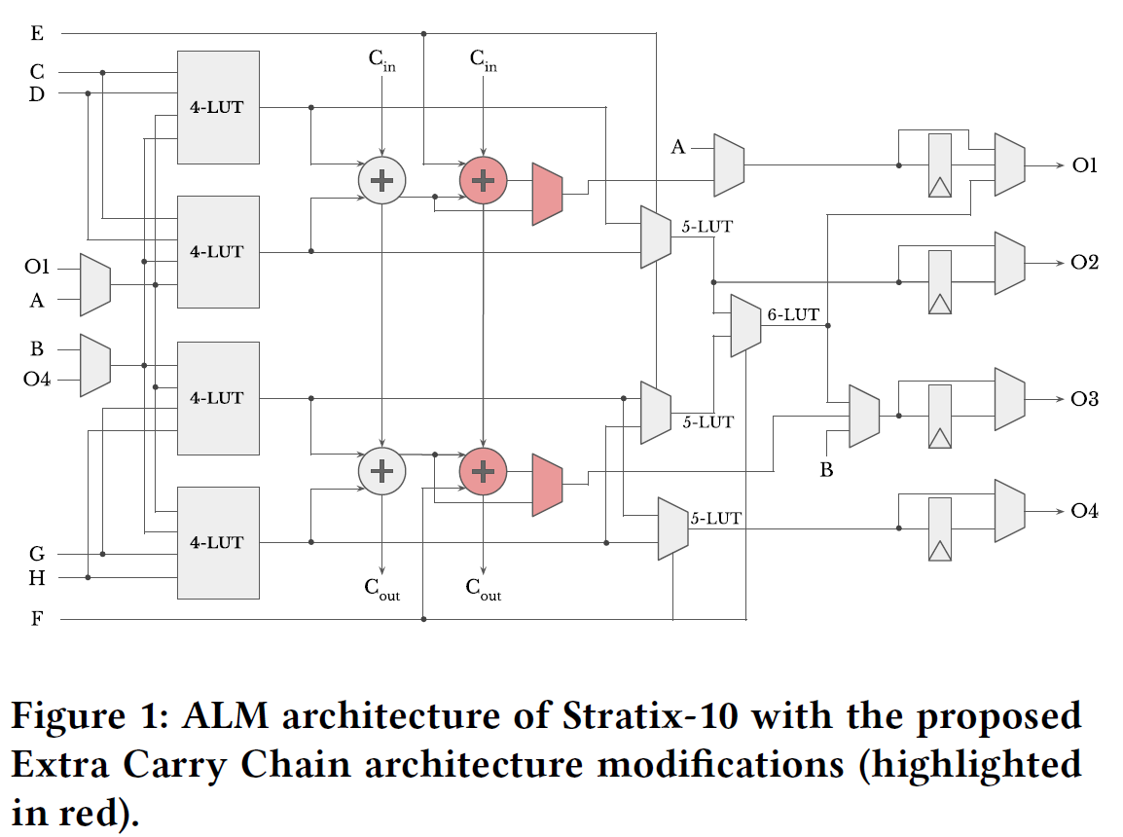
Method 1: Extra Carry Chain

Slide 5
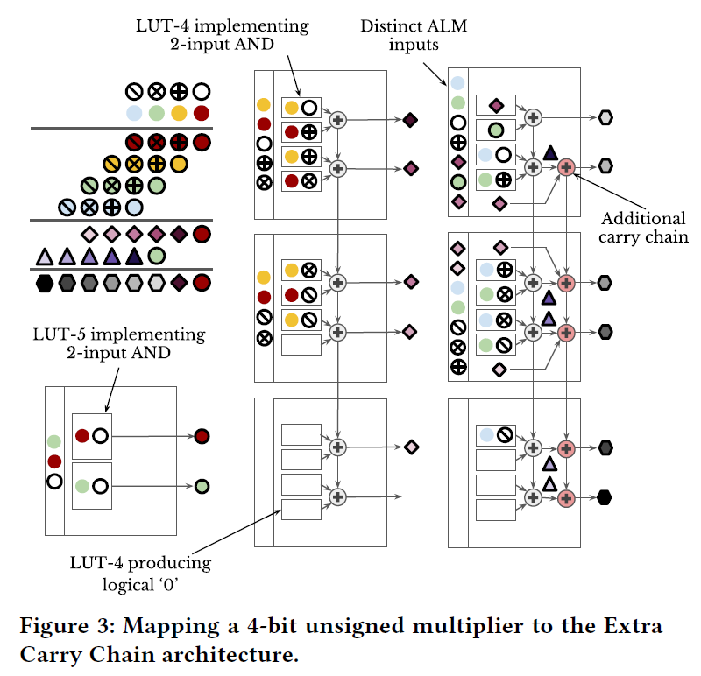
Method 1: Extra Carry Chain

Slide 6
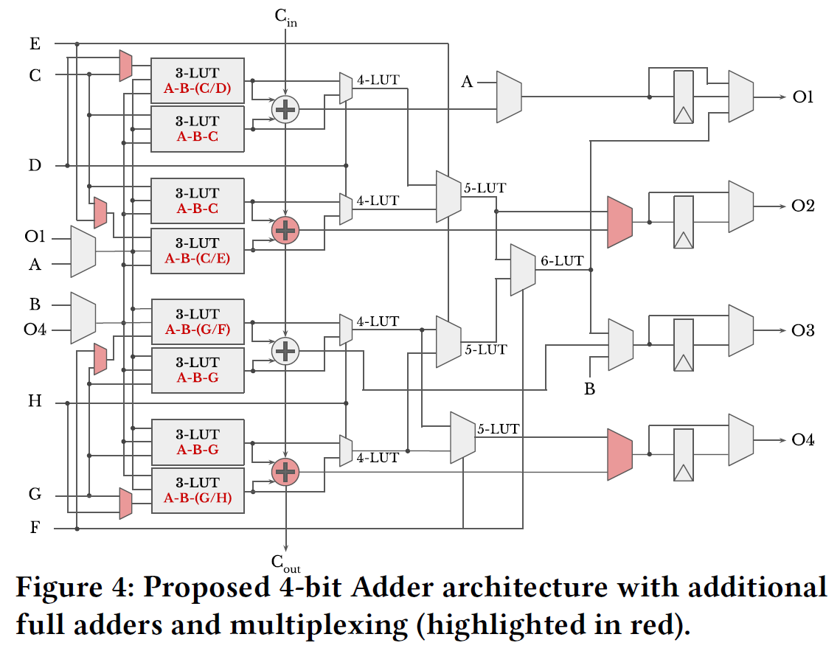
Method 2: 4-bit Adder

Slide 7
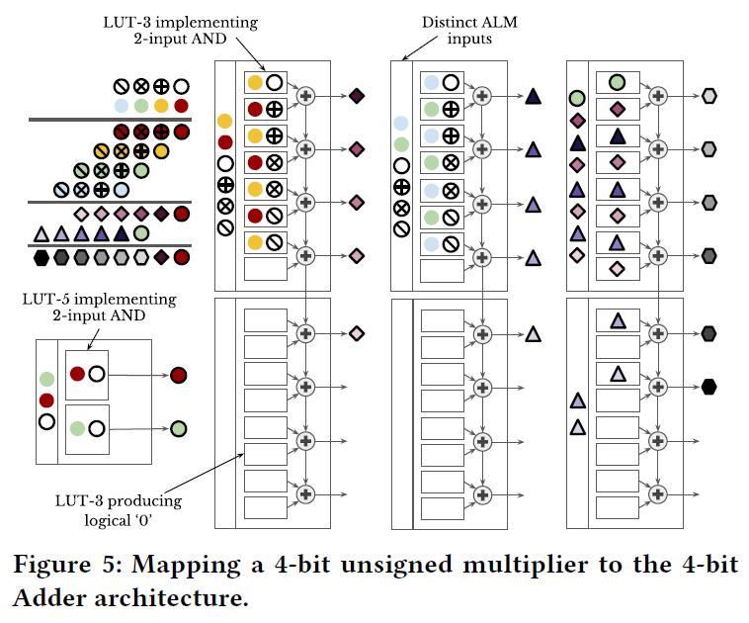
Method 2: 4-bit Adder

Slide 8
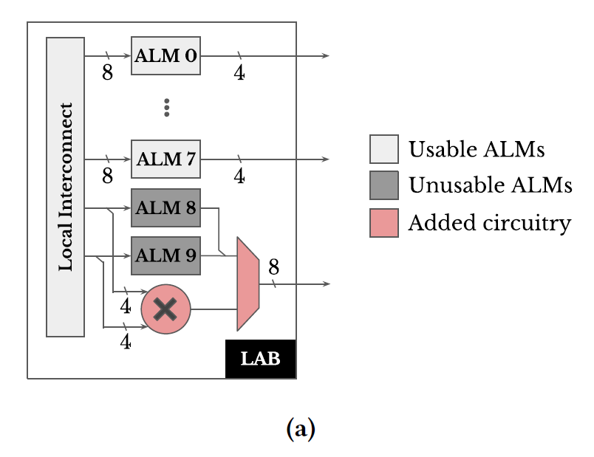
Method 3: Shadow Multipliers

Slide 9
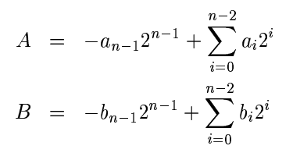
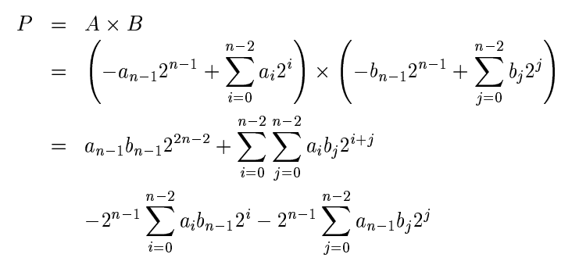
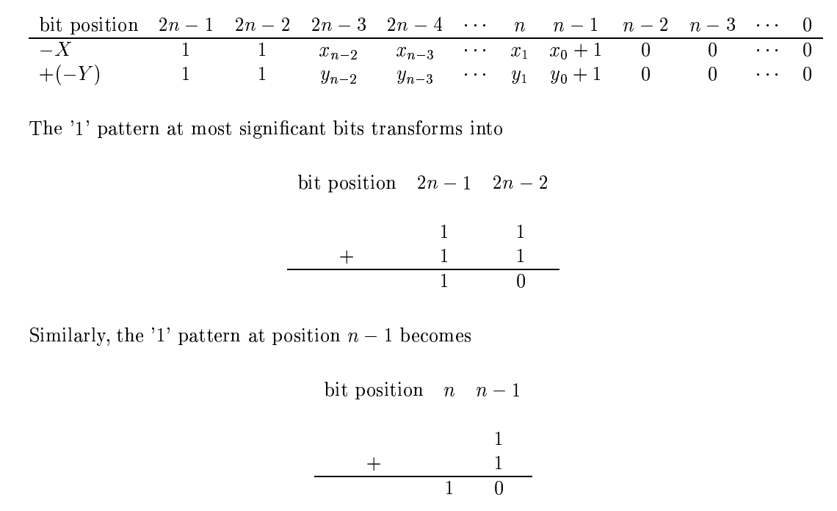
Baugh-Wooley Multiplier

Slide 10
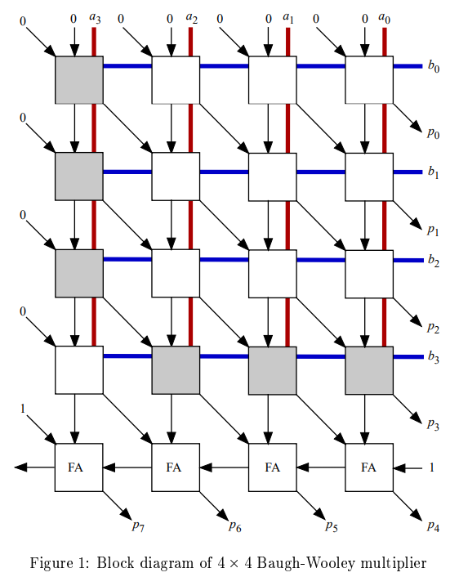
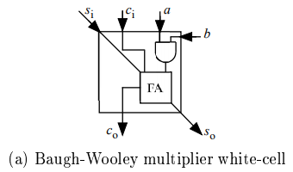
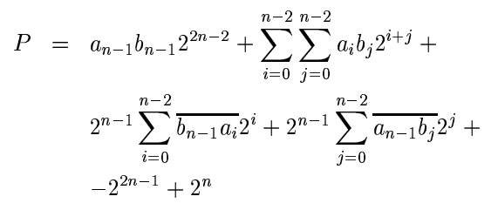
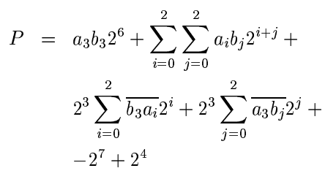
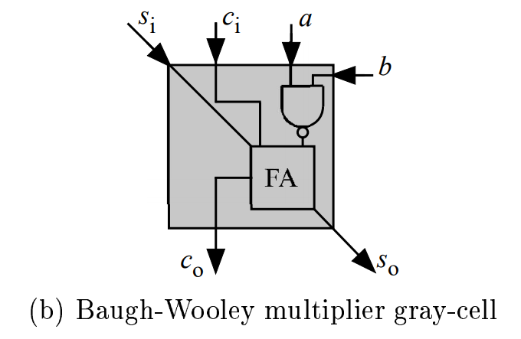
Baugh-Wooley Multiplier

Slide 11
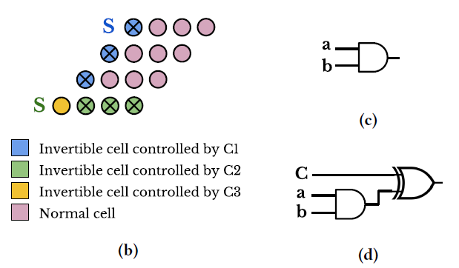
Method 3: Shadow Multipliers

Slide 12

Method 3: Shadow Multipliers
Conventional
Enhanced

Slide 13
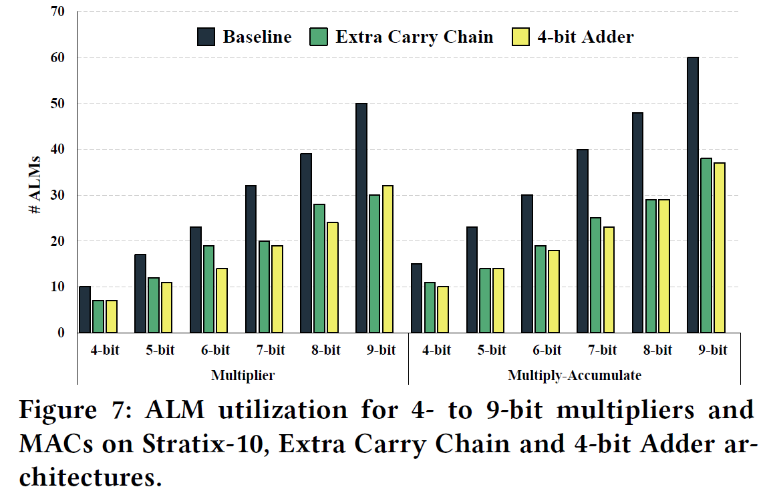
Evaluation

Slide 14
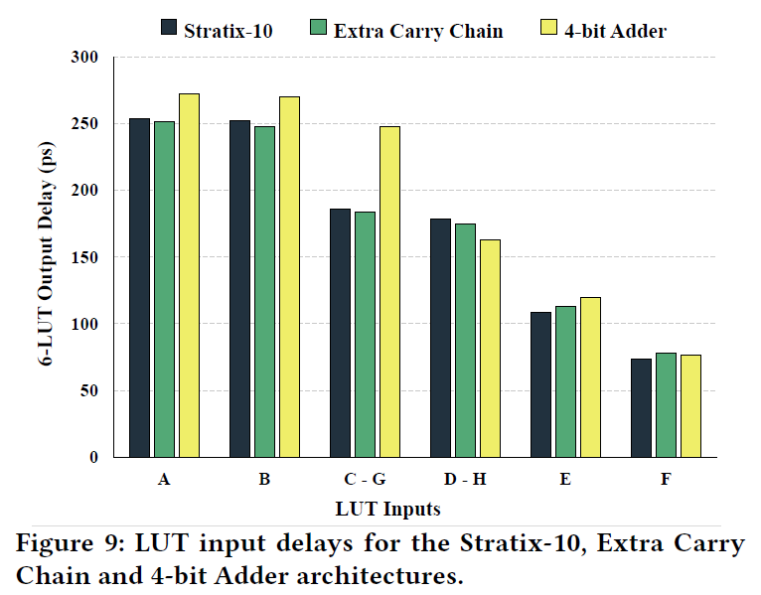
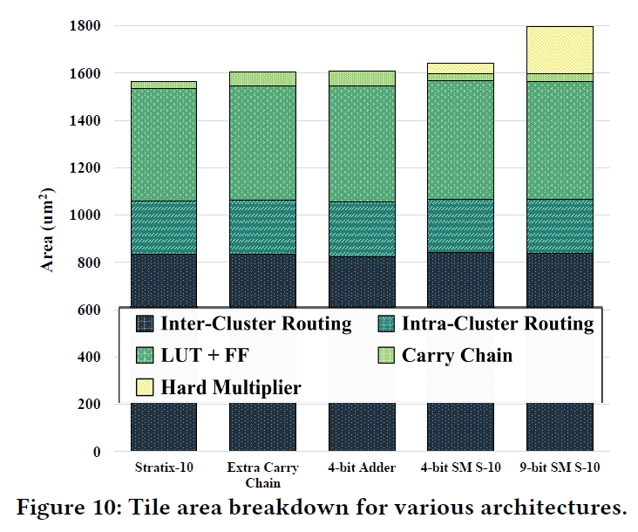
Evaluation

Slide 15
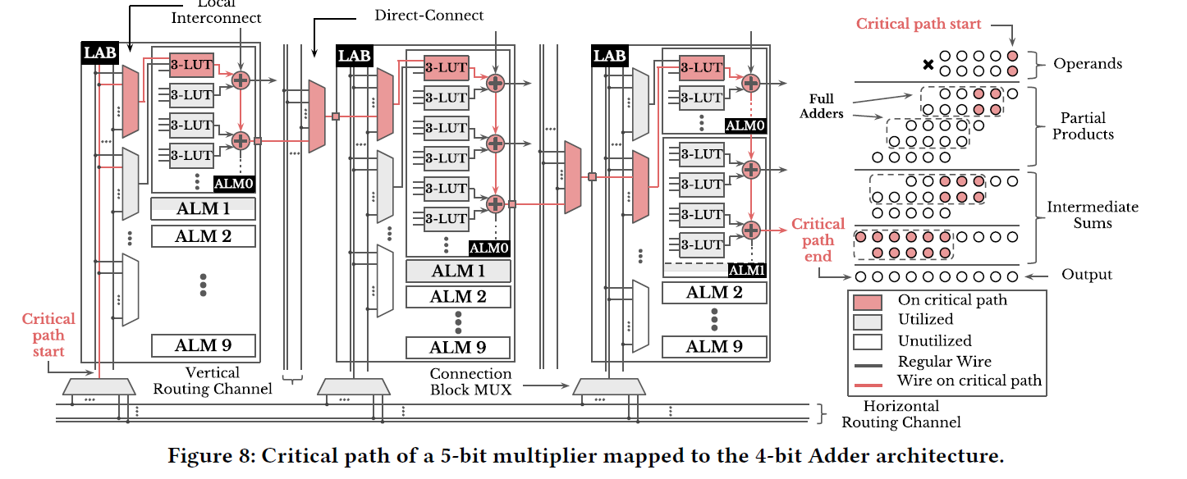
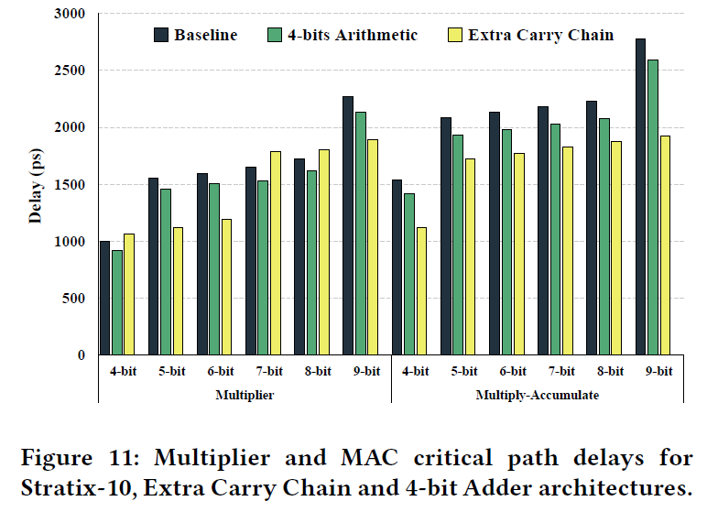
Evaluation

Slide 16
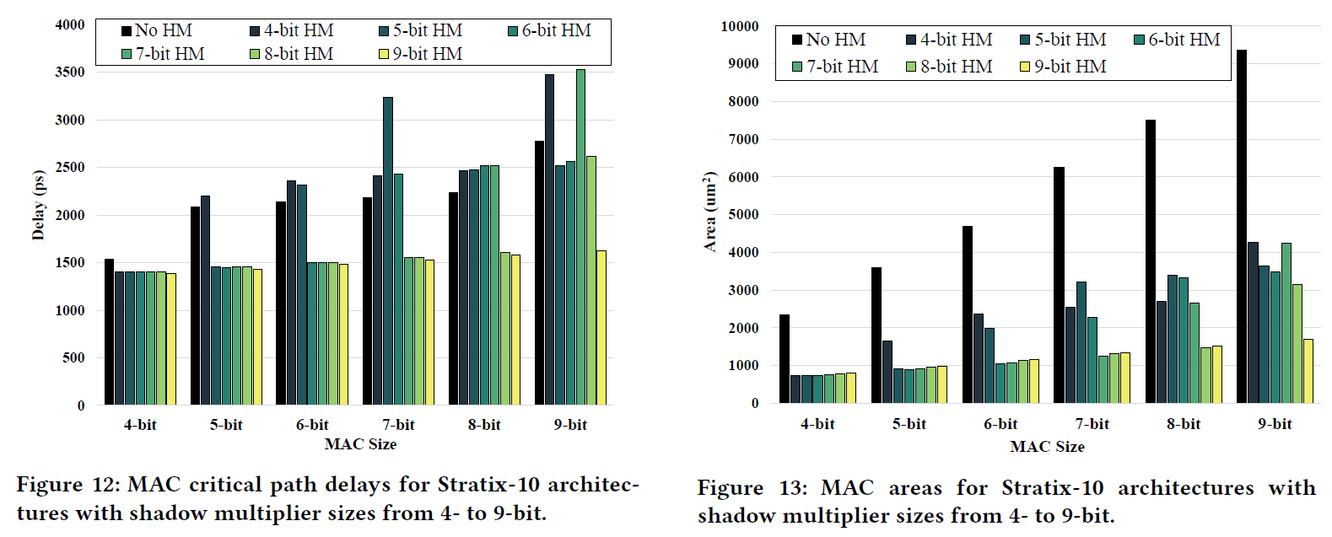
Evaluation

